Slide 1
New Workbook
File created on: 7/28/2023 5:17:41 AM

Slide 2
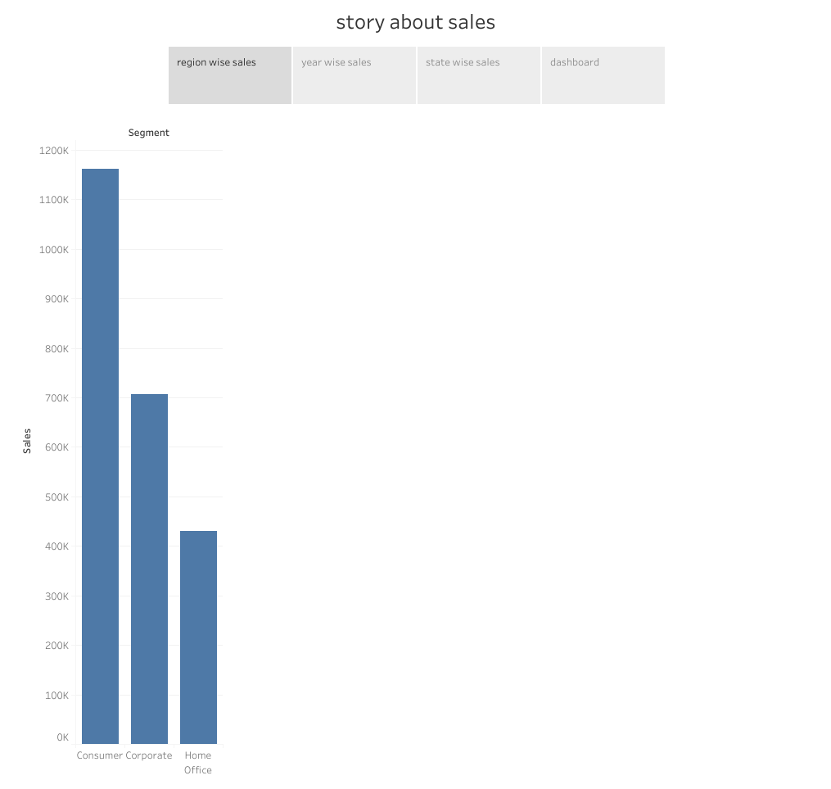

Slide 3
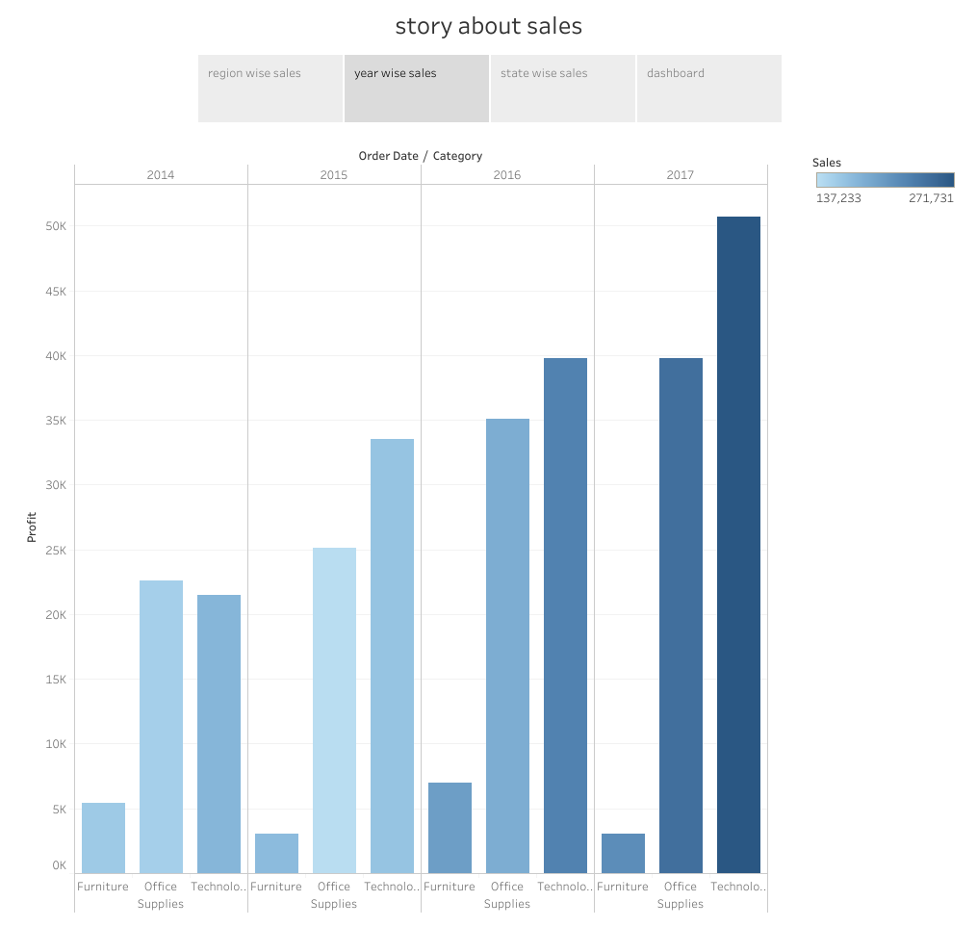

Slide 4
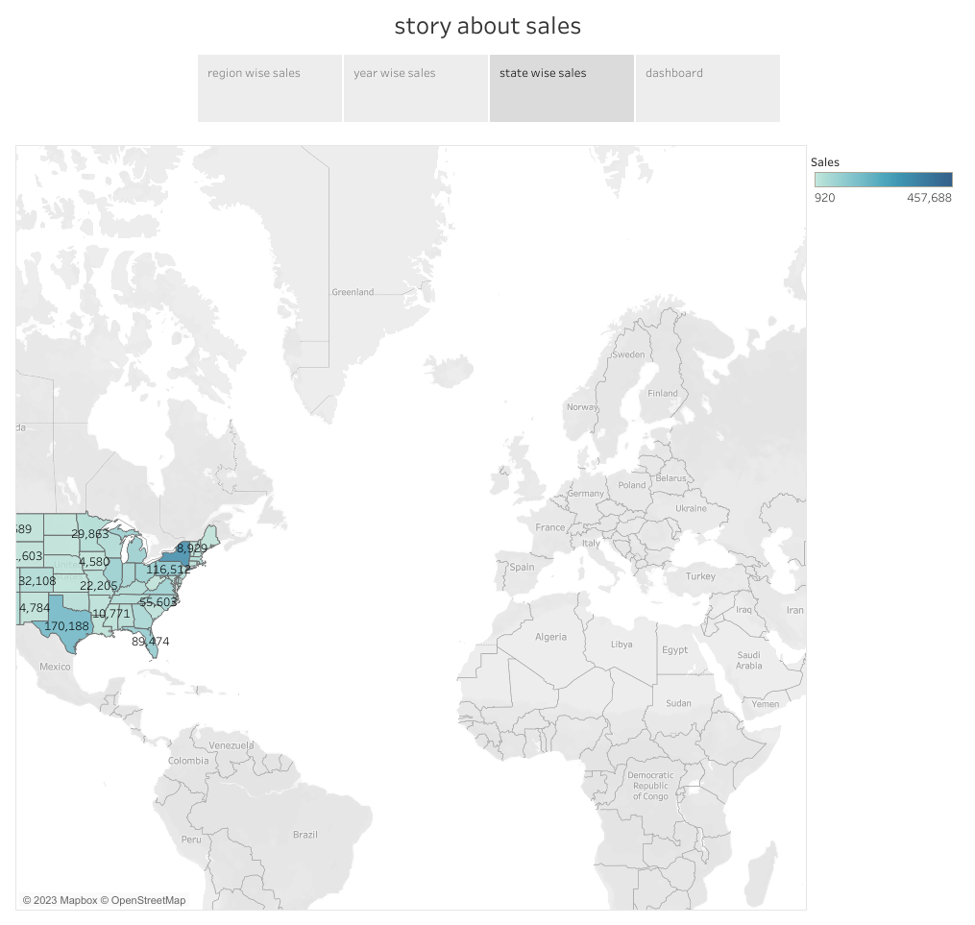

Slide 5
